Slide 1
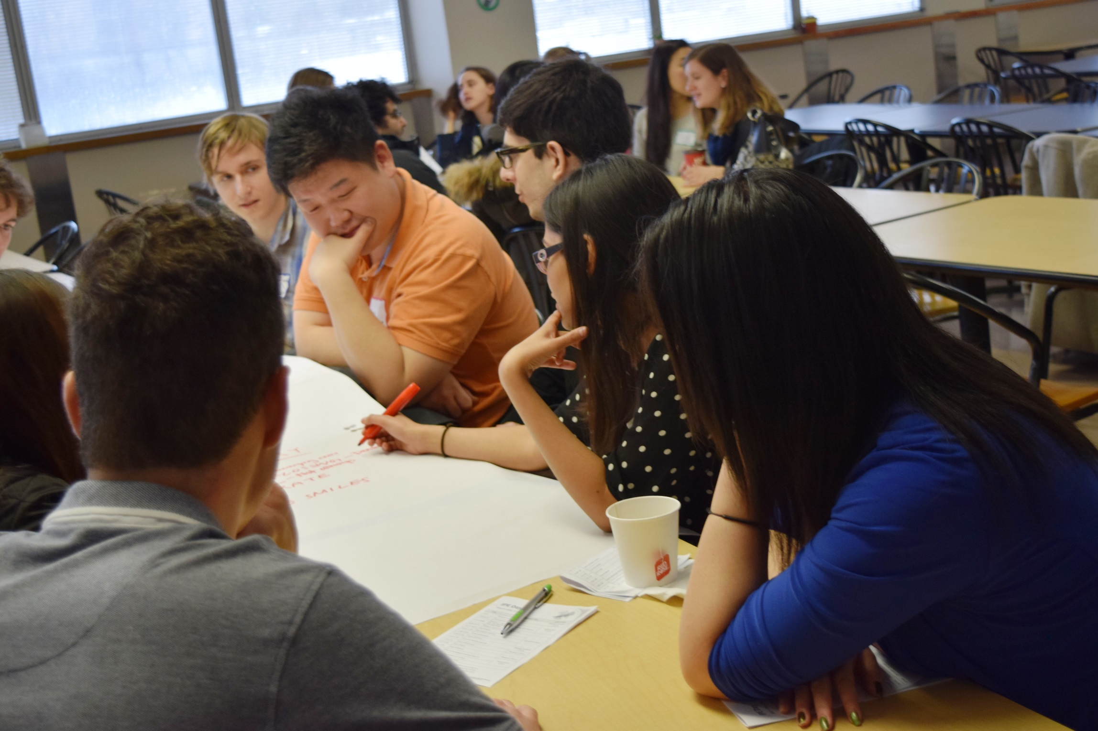
IPE Day at a Glance
Kevin Fung; Elaine Lillie
IPE Working Group Co-Chairs

Slide 2
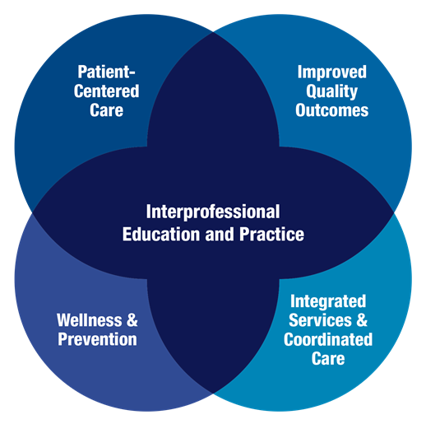
Preamble
IPE is important to teach
  Canadian Interprofessional Health Collaborative (CIHC) competencies
IPE is not taught well
  Accreditation
SWAHN opportunity
  Engage stakeholders
  Think outside the box

Slide 3
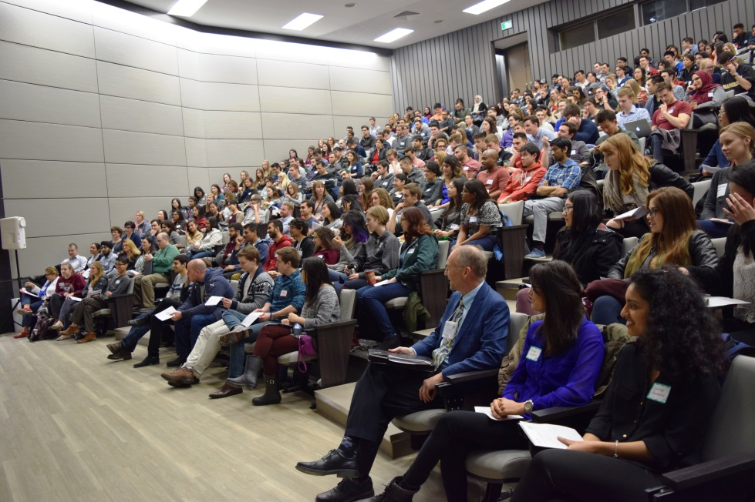
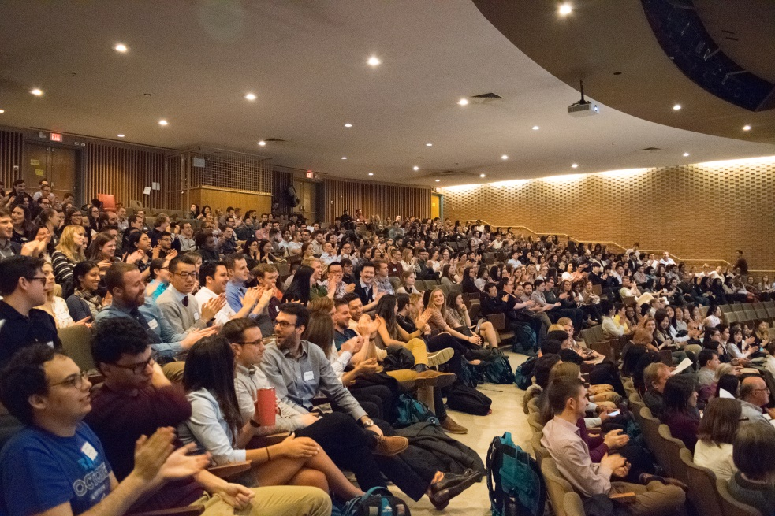
The Basics
In2016 ….
In 2017 ….
400+ students
Full day
25+ facilitators
Parallel event in Windsor
400+ students
½ day
40+ facilitators
Parallel event in Windsor

Slide 4
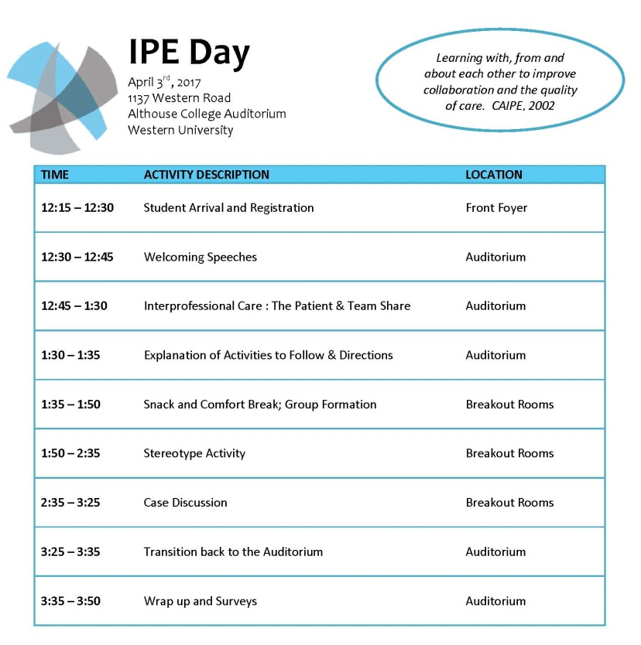
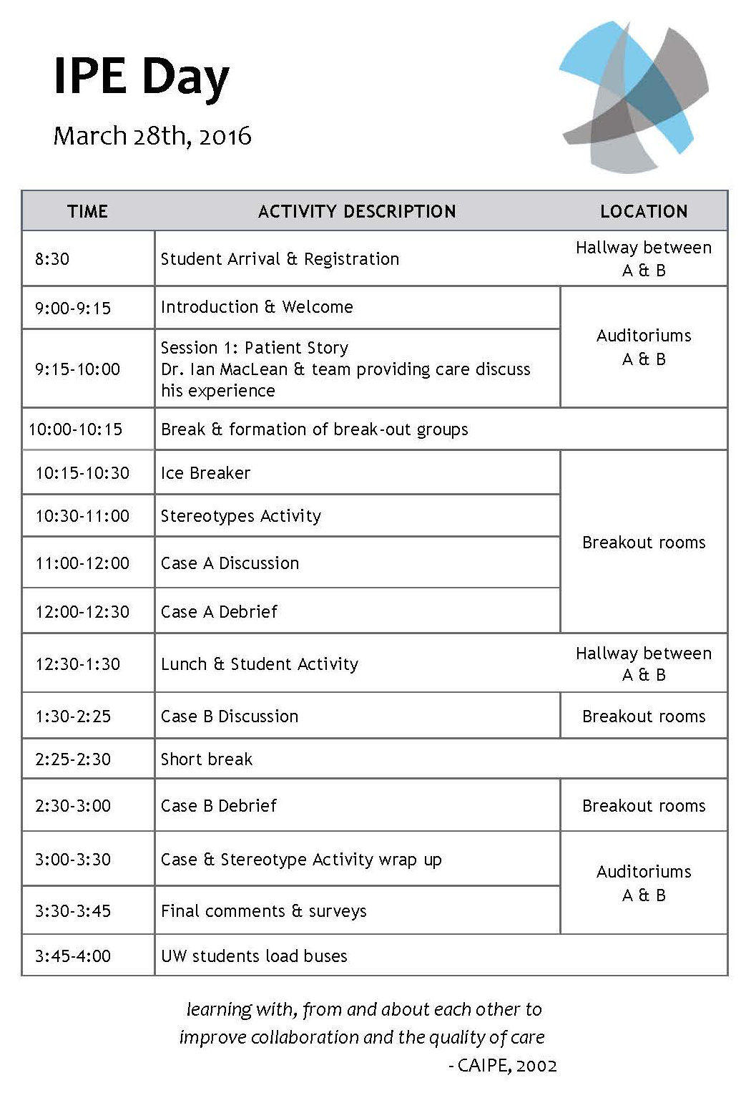
The Agenda

Slide 5
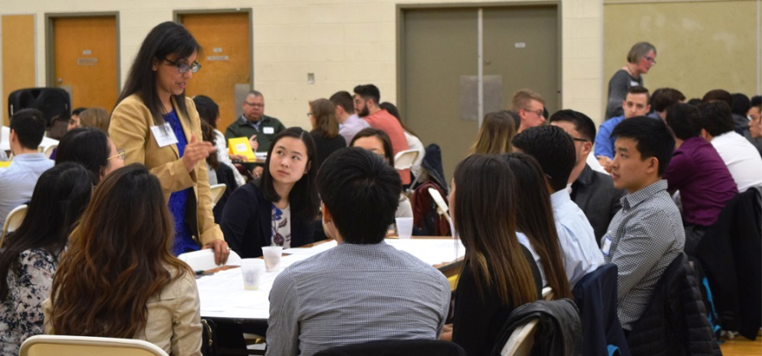
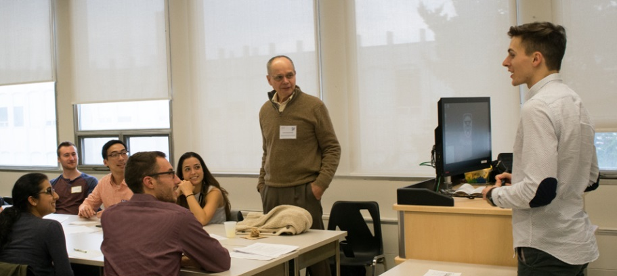
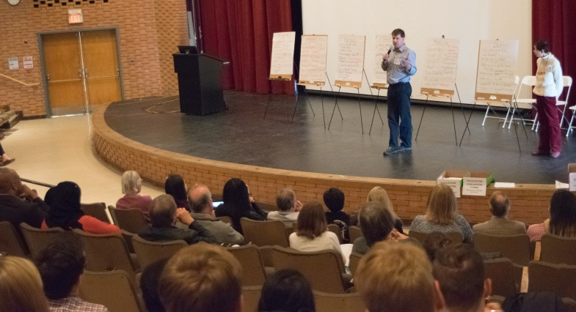
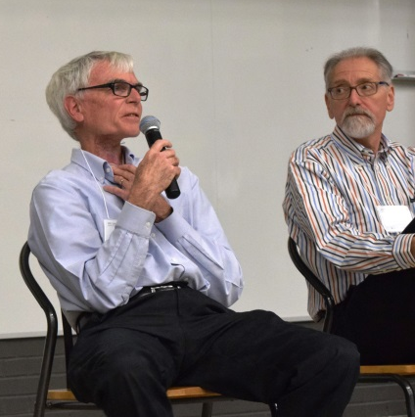
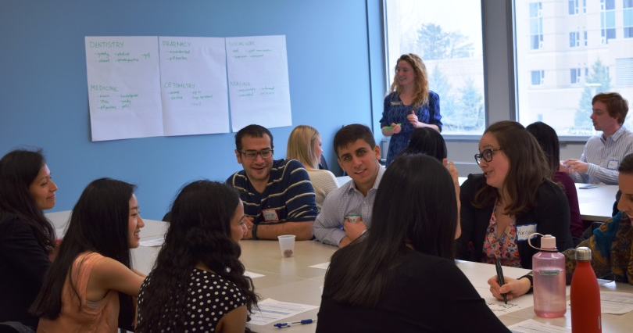
Sessions
Stereotypes Activity
Case Discussion
Patient Story

Slide 6
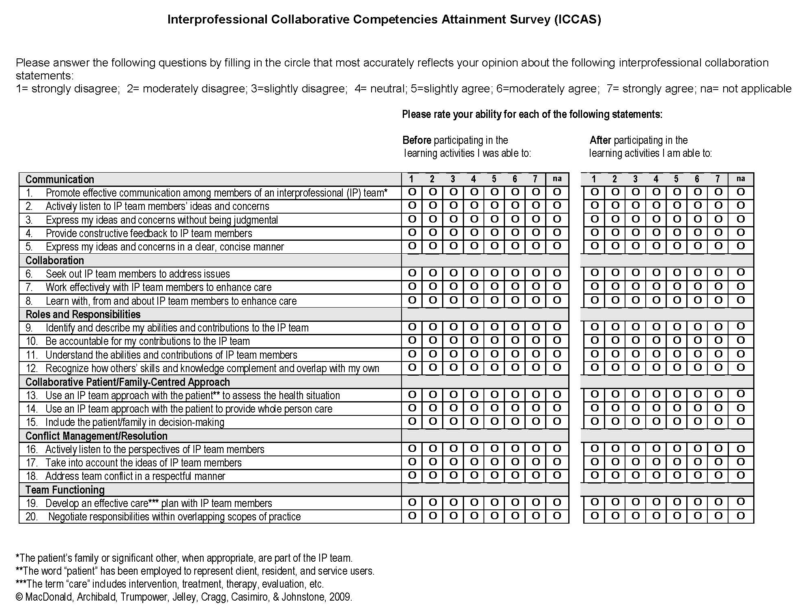

Program Evaluation
ICCAS Survey
Qualitative Questions
Wins
Suggestions
Surprises

Slide 7
Survey Says …
Improvement in all IPE competencies both years
Across the 5 disciplines, Collaboration was the topic that saw the most recurring improvement overall, followed by Team Functioning.
Facilitators gave an average rating of 4.47/5 (2016) and 4.5/5 (2017) to whether they felt the event was a “meaningful learning experience for students”

Slide 8
The Comments
All in all, I think this was a great inaugural day and I’m thrilled different programs and universities are working together to stress the importance of teamwork in healthcare. – Optometry student
I learned several things about role/scope of practice through informal conversations and organically during small groups. – Medical student volunteer
Things students liked:
Meeting other students in different professions
Hearing the diversity of perspectives
Openness and approachability of healthcare professionals
The demonstration of the value of interprofessional collaboration
A learning environment that encouraged participation
Small group sessions

Slide 9
Reflections
IPE Day – successful SWAHN initiative
This is just the beginning…
  Single educational event → springboard for longitudinal IPE curriculum
Process of organizing the day revealed systems-based challenges

Slide 10

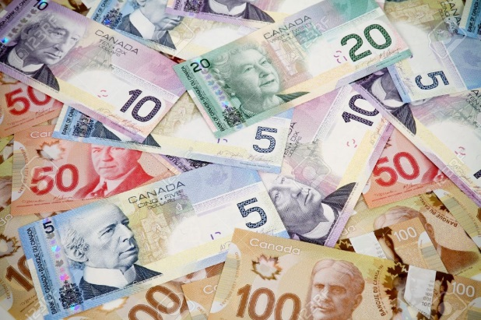


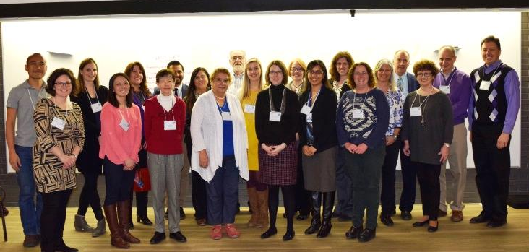
The Wish List – More ….
Professions
Funding
Food
Integration with other SWAHN groups
Facilitators

Slide 11
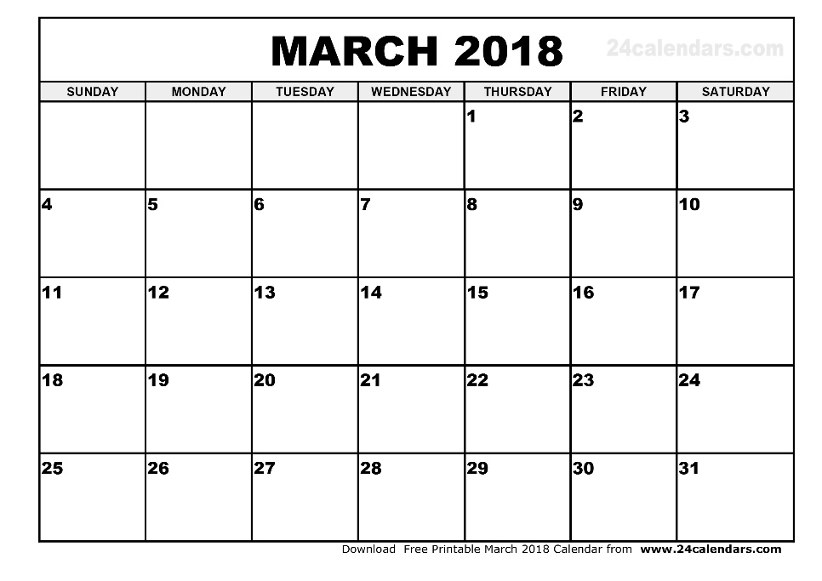
Looking Ahead to 2018
IPE Day
3.0
Save Monday, March 26

